Slide 1


UNIVERSITY INSTITUTE OF ENGINEERING
COMPUTER SCIENCE & ENGINEERING
Introduction to Information Security and Cryptography
(Subject Code:20CST-354/ITT-354)
Prepared By : Er. Puneet kaur(E6913)
INTRODUCTION
DISCOVER . LEARN . EMPOWER

Slide 2

MAC and SHA
www. cuchd.in Campus : Gharaun, Mohali

Slide 3
Message Authentication Code (MAC)
MAC algorithm is a symmetric key cryptographic technique to provide message authentication. For establishing MAC process, the sender and receiver share a symmetric key K.
Essentially, a MAC is an encrypted checksum generated on the underlying message that is sent along with a message to ensure message authentication.
The process of using MAC for authentication is depicted in the following illustration −

Slide 4
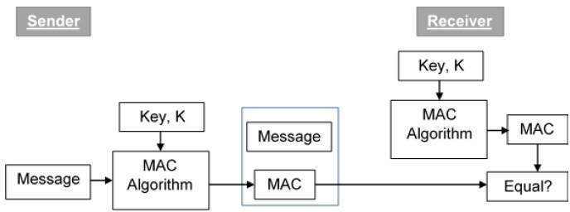
Message Authentication Code (MAC)

Slide 5
Message Authentication Code (MAC)
Let us now try to understand the entire process in detail −
The sender uses some publicly known MAC algorithm, inputs the message and the secret key K and produces a MAC value.
Similar to hash, MAC function also compresses an arbitrary long input into a fixed length output. The major difference between hash and MAC is that MAC uses secret key during the compression.
The sender forwards the message along with the MAC. Here, we assume that the message is sent in the clear, as we are concerned of providing message origin authentication, not confidentiality. If confidentiality is required then the message needs encryption.

Slide 6
Message Authentication Code (MAC)
On receipt of the message and the MAC, the receiver feeds the received message and the shared secret key K into the MAC algorithm and re-computes the MAC value.
The receiver now checks equality of freshly computed MAC with the MAC received from the sender. If they match, then the receiver accepts the message and assures himself that the message has been sent by the intended sender.
If the computed MAC does not match the MAC sent by the sender, the receiver cannot determine whether it is the message that has been altered or it is the origin that has been falsified. As a bottom-line, a receiver safely assumes that the message is not the genuine.

Slide 7
Limitations of MAC
Establishment of Shared Secret.
It can provide message authentication among pre-decided legitimate users who have shared key.
This requires establishment of shared secret prior to use of MAC.
Inability to Provide Non-Repudiation
Non-repudiation is the assurance that a message originator cannot deny any previously sent messages and commitments or actions.
MAC technique does not provide a non-repudiation service. If the sender and receiver get involved in a dispute over message origination, MACs cannot provide a proof that a message was indeed sent by the sender.
Though no third party can compute the MAC, still sender could deny having sent the message and claim that the receiver forged it, as it is impossible to determine which of the two parties computed the MAC.

Slide 8
Limitation of MAC
Both these limitations can be overcome by using the public key based digital signatures discussed in following section.
Digital signatures are the public-key primitives of message authentication. In the physical world, it is common to use handwritten signatures on handwritten or typed messages. They are used to bind signatory to the message.
Similarly, a digital signature is a technique that binds a person/entity to the digital data. This binding can be independently verified by receiver as well as any third party.
Digital signature is a cryptographic value that is calculated from the data and a secret key known only by the signer.

Slide 9
Hash functions
Hash functions are extremely useful and appear in almost all information security applications.
A hash function is a mathematical function that converts a numerical input value into another compressed numerical value. The input to the hash function is of arbitrary length but output is always of fixed length.
Values returned by a hash function are called message digest or simply hash values. The following picture illustrated hash function −

Slide 10
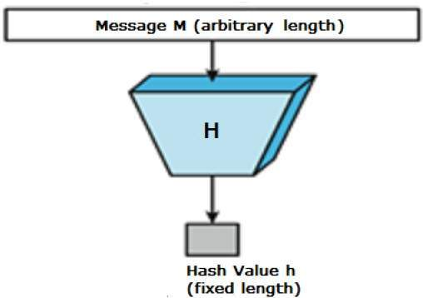

Slide 11
Features of Hash Functions
Fixed Length Output (Hash Value)
Hash function coverts data of arbitrary length to a fixed length. This process is often referred to as hashing the data.
In general, the hash is much smaller than the input data, hence hash functions are sometimes called compression functions.
Since a hash is a smaller representation of a larger data, it is also referred to as a digest.
Hash function with n bit output is referred to as an n-bit hash function. Popular hash functions generate values between 160 and 512 bits.
Efficiency of Operation
Generally for any hash function h with input x, computation of h(x) is a fast operation.
Computationally hash functions are much faster than a symmetric encryption.

Slide 12
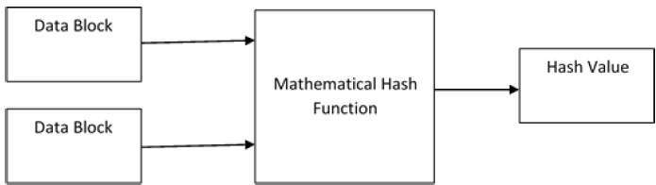
Design of Hashing Algorithms
At the heart of a hashing is a mathematical function that operates on two fixed-size blocks of data to create a hash code. This hash function forms the part of the hashing algorithm.
The size of each data block varies depending on the algorithm. Typically the block sizes are from 128 bits to 512 bits. The following illustration demonstrates hash function −
[4]

Slide 13
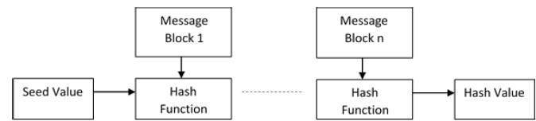
Design of Hashing Algorithms
Hashing algorithm involves rounds of above hash function like a block cipher. Each round takes an input of a fixed size, typically a combination of the most recent message block and the output of the last round.
This process is repeated for as many rounds as are required to hash the entire message. Schematic of hashing algorithm is depicted in the following illustration −

Slide 14
Design of Hashing Algorithms
Since, the hash value of first message block becomes an input to the second hash operation, output of which alters the result of the third operation, and so on. This effect, known as an avalanche effect of hashing.
Avalanche effect results in substantially different hash values for two messages that differ by even a single bit of data.
Understand the difference between hash function and algorithm correctly. The hash function generates a hash code by operating on two blocks of fixed-length binary data.
Hashing algorithm is a process for using the hash function, specifying how the message will be broken up and how the results from previous message blocks are chained together.

Slide 15
Features of hash functions in system security:
One-way function: Hash functions are designed to be one-way functions, meaning that it is easy to compute the hash value for a given input, but difficult to compute the input for a given hash value.
Deterministic: Hash functions are deterministic, meaning that given the same input, the output will always be the same. This makes hash functions useful for verifying the authenticity of data, as any changes to the data will result in a different hash value.
Fixed-size output: Hash functions produce a fixed-size output, regardless of the size of the input. This property makes hash functions useful for storing and transmitting data, as the hash value can be stored or transmitted more efficiently than the original data.
Collision resistance: Hash functions should be designed to be collision resistant, meaning that it is difficult to find two different inputs that produce the same hash value. This property ensures that attackers cannot create a false message that has the same hash value as a legitimate message.
Non-reversible: Hash functions are non-reversible, meaning that it is difficult or impossible to reverse the process of generating a hash value to recover the original input. This property makes hash functions useful for storing passwords or other sensitive information, as the original input cannot be recovered from the hash value.

Slide 16
Advantages:
Data integrity: Hash functions are useful for ensuring the integrity of data, as any changes to the data will result in a different hash value. This property makes hash functions a valuable tool for detecting data tampering or corruption.
Message authentication: Hash functions are useful for verifying the authenticity of messages, as any changes to the message will result in a different hash value. This property makes hash functions a valuable tool for verifying the source of a message and detecting message tampering.
Password storage: Hash functions are useful for storing passwords in a secure manner. Hashing the password ensures that the original password cannot be recovered from the hash value, making it more difficult for attackers to access user accounts.
Fast computation: Hash functions are designed to be fast to compute, making them useful for a variety of applications where efficiency is important.

Slide 17
Disadvantages
Collision attacks: Hash functions are vulnerable to collision attacks, where an attacker tries to find two different inputs that produce the same hash value. This can compromise the security of hash-based protocols, such as digital signatures or message authentication codes.
Rainbow table attacks: Hash functions are vulnerable to rainbow table attacks, where an attacker precomputes a table of hash values and their corresponding inputs, making it easier to crack password hashes.
Hash function weaknesses: Some hash functions have known weaknesses, such as the MD5 hash function, which is vulnerable to collision attacks. It is important to choose a hash function that is secure for the intended application.
Limited input size: Hash functions produce a fixed-size output, regardless of the size of the input. This can lead to collisions if the input size is larger than the hash function output size.

Slide 18
Popular Hash Functions
Message Digest (MD) MD5 was most popular and widely used hash function for quite some years. The MD family comprises of hash functions MD2, MD4, MD5 and MD6. It was adopted as Internet Standard RFC 1321. It is a 128-bit hash function.
Secure Hash Function (SHA) Family of SHA comprise of four SHA algorithms; SHA-0, SHA-1, SHA-2, and SHA-3. Though from same family, there are structurally different.
The RIPEMD is an acronym for RACE Integrity Primitives Evaluation Message Digest. This set of hash functions was designed by open research community and generally known as a family of European hash functions.

Slide 19
Simple Hash Functions
All hash functions operate using this general principle.
The input (message, file, etc.) is viewed as a sequence of n-bit blocks.
The input is processed one block at a time in an iterative fashion to produce an n-bit hash function.

Slide 20

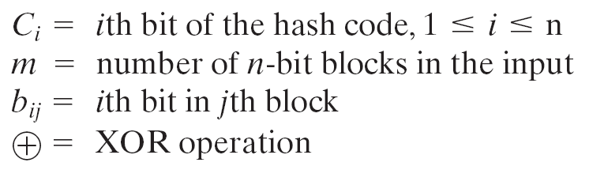
Simple Hash Functions
One of the simplest hash functions is the bit-by-bit exclusive-OR (XOR) of every block.

Slide 21
Simple Hash Functions
A way of improvement is to perform a one-bit circular shift, or rotation, on the hash value after each block is processed.
The procedure can be summarized as follows.
1. Initially set the n-bit hash value to zero.
2. Process each successive n-bit block of data as follows:
a. Rotate the current hash value to the left by one bit.
b. XOR the block into the hash value.

Slide 22
Simple Hash Functions
A simple XOR or rotated XOR (RXOR) is insufficient if only the hash code is encrypted.
Such a simple function could be useful when the message together with the hash code is encrypted
A technique originally proposed by the National Bureau of Standards used the simple XOR applied to 64-bit blocks of the message and then an encryption of the entire message that used the cipher block chaining (CBC) mode.

Slide 23

Simple Hash Functions
Given a message M consisting of a sequence of 64-bit blocks X₁, X₂, … , X_{N}
Hash code h = H(M) is the block-by-block XOR of all blocks.
Append the hash code as the final block:
Encrypt the entire message plus hash code using CBC mode to produce the encrypted message Y₁, Y₂, … , Y_{N+1}

Slide 24
Security Requirement of Hash Function
Collision
A collision occurs if we have x ≠ y and H(x) = H(y)
We use hash functions for data integrity, collisions are clearly undesirable.

Slide 25
Security Requirement of Hash Function
Variable input size
H can be applied to a block of data of any size.
2. Fixed output size
H produces a fixed-length output.
Efficiency
H(x) is relatively easy to compute for any given x, making both hardware and software implementations practical.

Slide 26
Security Requirement of Hash Function
Pre-image
For a hash value h = H(x), we say that x is the pre-image of h.
x is a data block whose hash function, using the function H, is h.
H is a many-to-one mapping
For any given hash value h, there will in general be multiple preimages.

Slide 27
Security Requirement of Hash Function
Pre-image resistant (one-way property)
For any given hash value h, it is computationally infeasible to find y such that H(y) = h.
5. Second pre-image resistant (weak collision resistant)
For any given block x, it is computationally infeasible to find y ≠ x with H(y) = H(x).
Guarantees that it is impossible to find an alternative message with the same hash value as a given message.

Slide 28
Security Requirement of Hash Function
Collision resistant (strong collision resistant)
It is computationally infeasible to find any pair (x, y) such that H(x) = H(y).
A hash function that satisfies the first five properties is referred to as a weak hash function.
If the sixth property, collision resistant, is also satisfied, then it is referred to as a strong hash function.

Slide 29
Security Requirement of Hash Function
7. Pseudorandomness
Output of H meets standard tests for pseudorandomness.
What is pseudorandomness?
The principle requirement for this capability is that the generated number stream be unpredictable.

Slide 30
Secure Hash Algorithm
Most widely used hash function.
Developed by the National Institute of Standards and Technology (NIST).
SHA is based on the hash function MD4.
Different version enhanced capabilities of SHA.
Under Discussion -> SHA-512

Slide 31
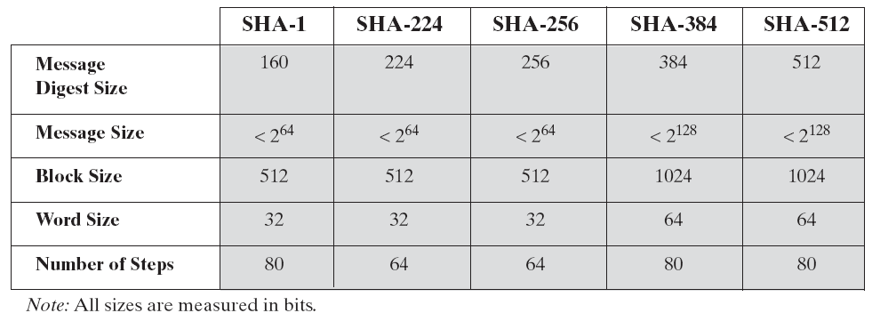
Secure Hash Algorithm
Comparison of SHA Versions

Slide 32
References
http://www.brainkart.com/article/Classical-Encryption-Techniques_8339/
https://www.tutorialspoint.com/cryptography/index.htm
https://www.geeksforgeeks.org/cryptography-introduction/
https://www.techopedia.com/definition/1770/cryptography#:~:text=Cryptography%20involves%20creating%20written%20or,information%20to%20be%20kept%20secret.&text=Information%20security%20uses%20cryptography%20on,transit%20and%20while%20being%20stored.
https://www2.slideshare.net/lineking/classical-encryption-techniques-in-network-security?qid=e388c29f-793d-4f2b-bcaf-9d22e9ca07b5&v=&b=&from_search=1

Slide 33
E- Books Recommended
https://www.pdfdrive.com/cyber-security-books.html
https://bookauthority.org/books/new-cyber-security-ebooks
https://bookauthority.org/books/best-cyber-security-ebooks
https://www.freetechbooks.com/information-security-f52.html

Slide 34
MD5
The MD5 (message-digest algorithm) hashing algorithm is a one-way cryptographic function that accepts a message of any length as input and returns as output a fixed-length digest value to be used for authenticating the original message.
The MD5 hash function was originally designed for use as a secure cryptographic hash algorithm for authenticating digital signatures. But MD5 has been deprecated for uses other than as a noncryptographic checksum to verify data integrity and detect unintentional data corruption.

